Slide 1
Collaborative Filtering for Anime Recommendation
Nitin Reddy
Nishant Kumar
Aayush Mandhyan

Slide 2
Project Goal
The Recommender systems look at patterns of activities between different users and different products to produce these recommendations.
From Amazon to Netflix, Google to Goodreads, recommendation engines are one of the most widely used applications of machine learning techniques.
In this project, we will use collaborative filtering to create an anime recommendation system using Python.

Slide 3
Outline of Presentation
Description
User Interface
Flow Diagram
Constraints

Slide 4
Description
Recommender systems, generally uses collaborative filtering algorithm to fetch the results.
A recommendation engine would provide recommendations of items based on the user history that has been gathered.
Our anime recommendation engine filters the data using collaborative filtering and provides a list of anime the user might like.
The collaborative filtering algorithm uses "User Behavior" for recommending items.

Slide 5
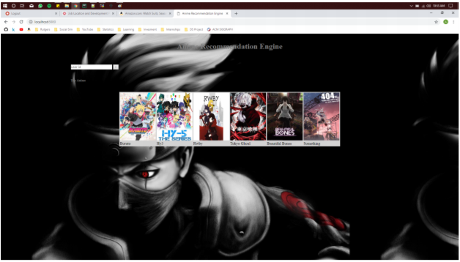
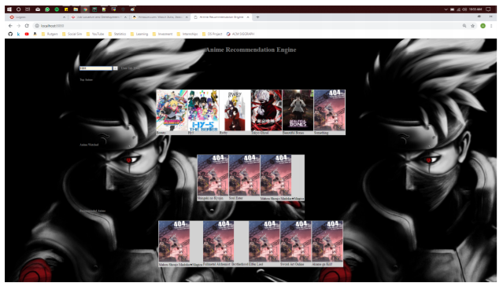
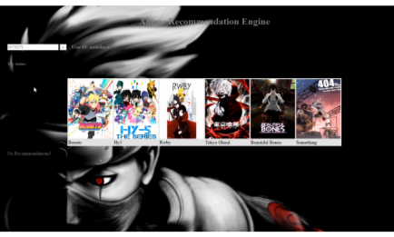
User Interface
← Login Page
After User Login ->
← Error Handling

Slide 6
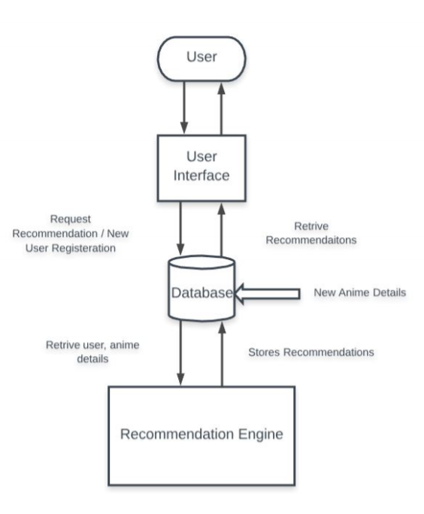
Flow Diagram

Slide 7
Constraints
New User: In case of a new user we do not have user preferences to recommend anime.
New Movie: In case of new anime we do not have user ratings for the anime.
Very Less Ratings: If users are not providing ratings for the movie, then we will not be able to predict correctly
False Ratings: If the user gives any random rating, then that will also influence the recommendation.

Slide 8
Future Extensions
Item- item similarity introduction
K mean Clustering based recommendation
ML method based recommendation

Slide 9
References and Resources used
https://www.kaggle.com/CooperUnion/anime-recommendations-database
https://en.wikipedia.org/wiki/Collaborative_filtering
https://en.wikipedia.org/wiki/Cosine_similarity
Libraries Used :– scikit-Learn, numpy, pandas, pickle, scipy, operator

